Slide 1

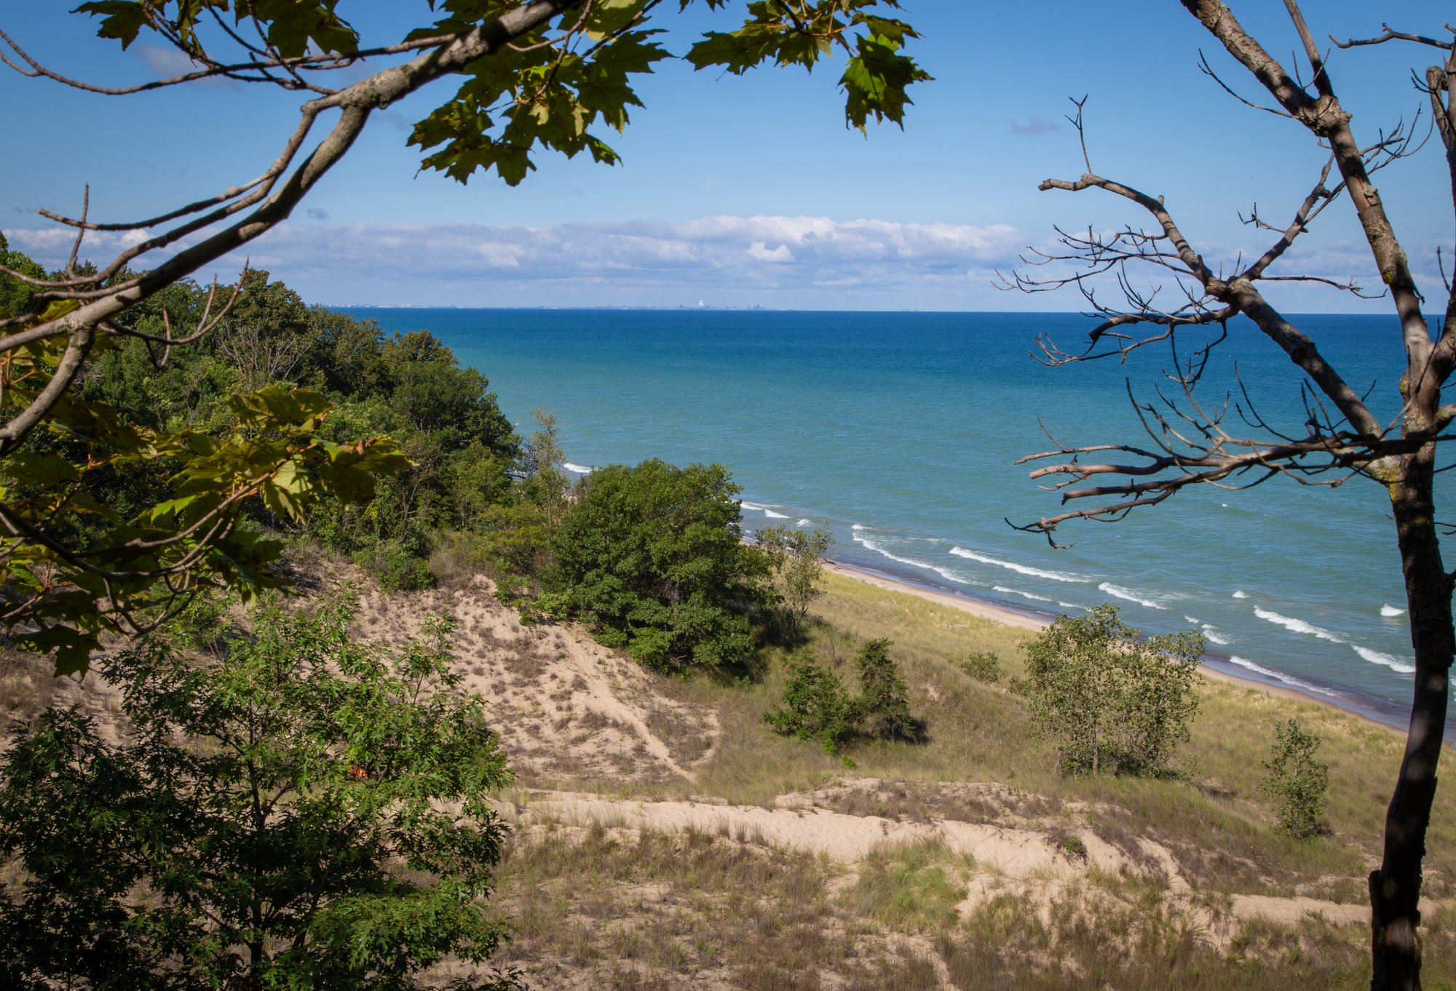
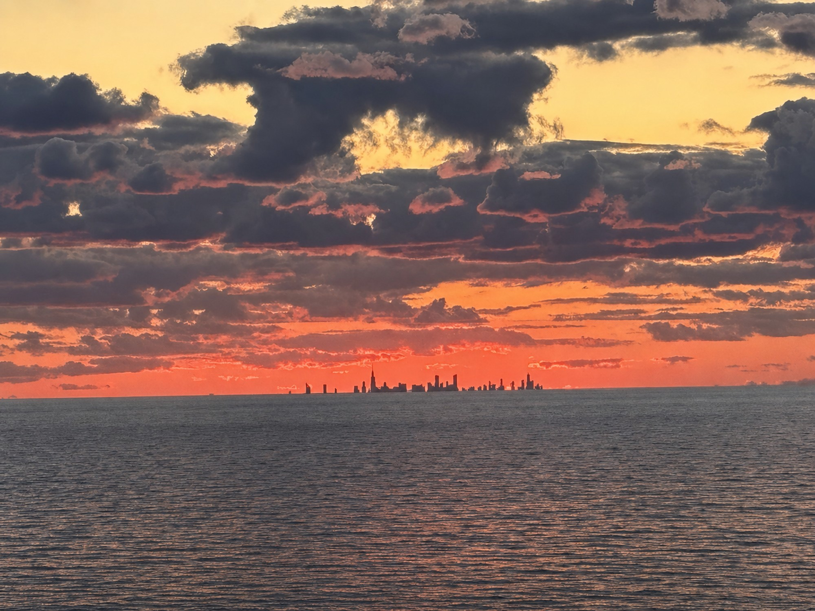
SOLO INVESTOR / OCTOBER 13, 2026
Indiana Dunes Club
Reconciled investment planning basis | 88-home program | One current source
Solo Investor
88-home horizontal development model
Corrected workbook, current assumptions, and the outstanding diligence items. No implied investor IRR or tax benefit.
Sponsor planning assumptions. Not an offer, guaranteed return, appraisal or approval.
Source cells: SUMMARY; Proforma; Lot Pricing Worksheet
https://indianadunesclub.pplx.app/downloads/Indiana-Dunes-Club-Financials-and-Proforma.xlsx
1
Notes:
Current source: corrected October 13, 2026 workbook. SUMMARY; Proforma; Lot Pricing Worksheet. https://indianadunesclub.pplx.app/downloads/Indiana-Dunes-Club-Financials-and-Proforma.xlsx
All figures are sponsor planning assumptions. Preserve separate horizontal and vertical scopes. Acquisition=0 is not verified free land. Investor terms and legal/tax eligibility require confirmation.

Slide 2
SOLO INVESTOR / OCTOBER 13, 2026
88 homes across 10 priced product rows
Current sponsor program; not certification of an approved plat.
Product
Homes
Home SF
Allocated lot
Crescent Homes
8
2,800
$500,000
Court Homes
6
1,500
$300,000
Manor Homes
5
3,100
$600,000
Big House Condo
12
900
$225,000
Treehouses
4
1,100
$250,000
Pool Bungalows
9
1,600
$300,000
Lake Cottages (4 pack)
8
2,350
$450,000
Dune Homes
9
2,700
$400,000
Lake Cottages (6 pack)
24
2,100
$450,000
Forest Homes
3
3,600
$750,000
Sponsor planning assumptions. Not an offer, guaranteed return, appraisal or approval.
Source cells: Lot Pricing Worksheet!A2:P12
https://indianadunesclub.pplx.app/downloads/Indiana-Dunes-Club-Financials-and-Proforma.xlsx
2
Notes:
Current source: corrected October 13, 2026 workbook. Lot Pricing Worksheet!A2:P12. https://indianadunesclub.pplx.app/downloads/Indiana-Dunes-Club-Financials-and-Proforma.xlsx
All figures are sponsor planning assumptions. Preserve separate horizontal and vertical scopes. Acquisition=0 is not verified free land. Investor terms and legal/tax eligibility require confirmation.

Slide 3
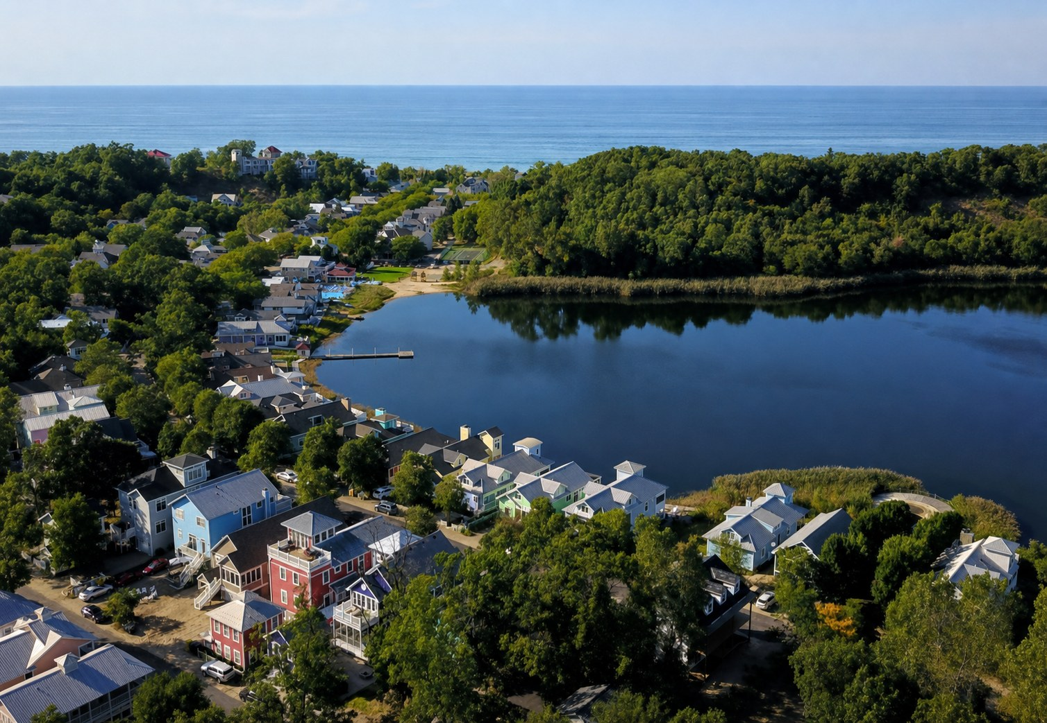
SOLO INVESTOR / OCTOBER 13, 2026
One construction assumption: $350 per SF
Target home value includes allocated lot value. It is not a quoted turnkey price.
Product
Build / home
Target / home
Crescent Homes
$980,000
$1,480,000
Court Homes
$525,000
$825,000
Manor Homes
$1,085,000
$1,685,000
Big House Condo
$315,000
$540,000
Treehouses
$385,000
$635,000
Pool Bungalows
$560,000
$860,000
Lake Cottages (4 pack)
$822,500
$1,272,500
Dune Homes
$945,000
$1,345,000
Lake Cottages (6 pack)
$735,000
$1,185,000
Forest Homes
$1,260,000
$2,010,000
Sponsor planning assumptions. Not an offer, guaranteed return, appraisal or approval.
Source cells: Lot Pricing Worksheet!I2:P12
https://indianadunesclub.pplx.app/downloads/Indiana-Dunes-Club-Financials-and-Proforma.xlsx
3
Notes:
Current source: corrected October 13, 2026 workbook. Lot Pricing Worksheet!I2:P12. https://indianadunesclub.pplx.app/downloads/Indiana-Dunes-Club-Financials-and-Proforma.xlsx
All figures are sponsor planning assumptions. Preserve separate horizontal and vertical scopes. Acquisition=0 is not verified free land. Investor terms and legal/tax eligibility require confirmation.

Slide 4
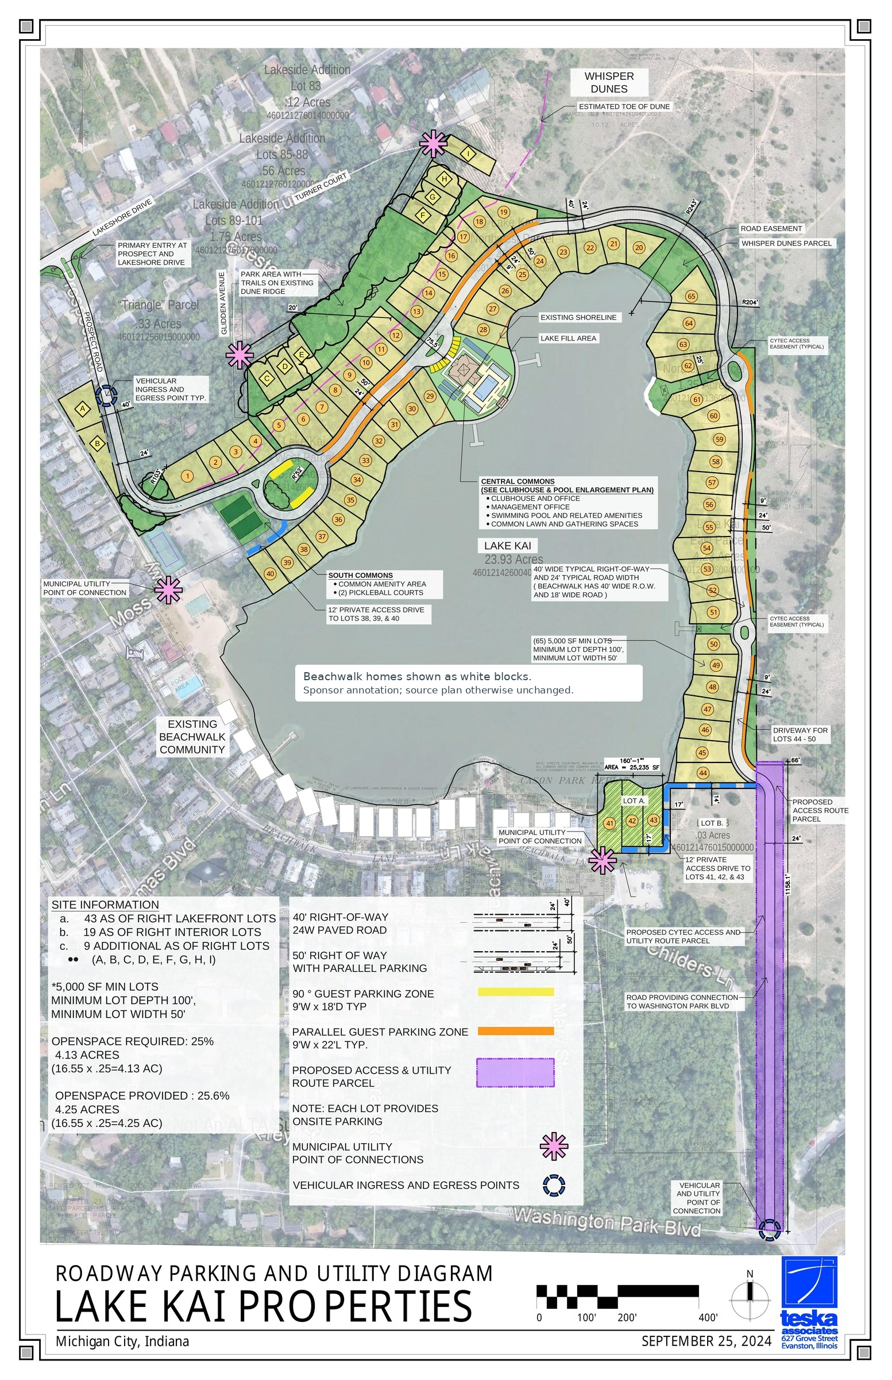
SOLO INVESTOR / OCTOBER 13, 2026
Do not combine different financial scopes
The workbook separates horizontal development from home construction and target value.
HORIZONTAL USES
VERTICAL CONSTRUCTION
TARGET FINISHED VALUE
$11.70M
$63.28M
$98.73M
Developer fee, entitlement, hard and soft costs.
88 homes at $350/SF. Separate from horizontal uses.
Includes allocated lot value; not a cost budget or confirmed sales.
Sponsor planning assumptions. Not an offer, guaranteed return, appraisal or approval.
Source cells: SUMMARY!E32; Lot Pricing Worksheet!G12, M12, P12
https://indianadunesclub.pplx.app/downloads/Indiana-Dunes-Club-Financials-and-Proforma.xlsx
4
Notes:
Current source: corrected October 13, 2026 workbook. SUMMARY!E32; Lot Pricing Worksheet!G12, M12, P12. https://indianadunesclub.pplx.app/downloads/Indiana-Dunes-Club-Financials-and-Proforma.xlsx
All figures are sponsor planning assumptions. Preserve separate horizontal and vertical scopes. Acquisition=0 is not verified free land. Investor terms and legal/tax eligibility require confirmation.

Slide 5
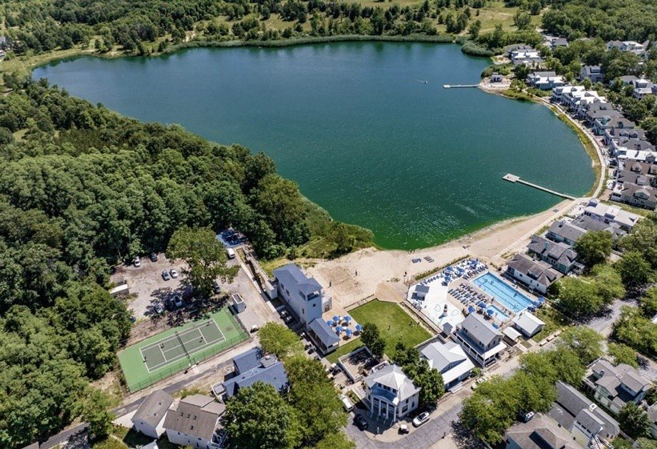
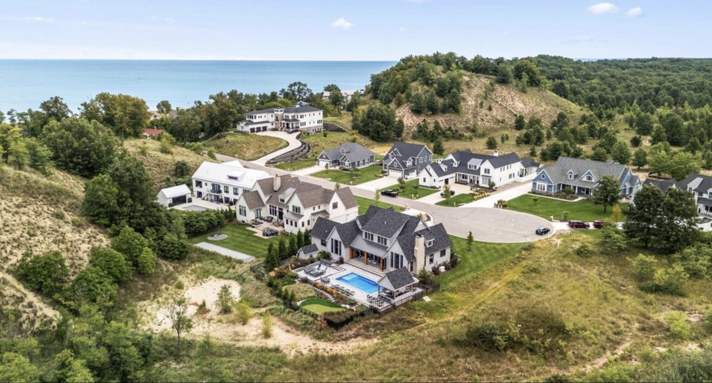
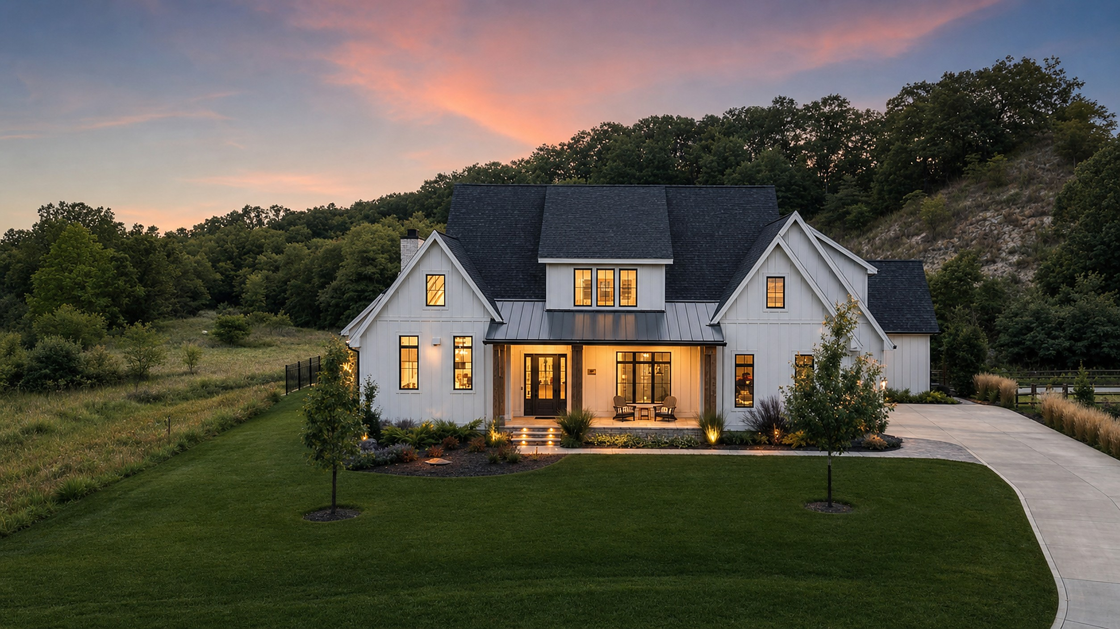
SOLO INVESTOR / OCTOBER 13, 2026
Modeled development uses: $11.70M
Acquisition is entered as zero. Confirm actual land contribution or purchase treatment.
Development use
Modeled amount
Developer fee
$600,000
Entitlement
$1,435,500
Horizontal / amenity hard costs
$8,219,012
Soft costs
$1,445,988
Total modeled uses
$11,700,500
Sponsor planning assumptions. Not an offer, guaranteed return, appraisal or approval.
Source cells: SUMMARY!E24:E32
https://indianadunesclub.pplx.app/downloads/Indiana-Dunes-Club-Financials-and-Proforma.xlsx
5
Notes:
Current source: corrected October 13, 2026 workbook. SUMMARY!E24:E32. https://indianadunesclub.pplx.app/downloads/Indiana-Dunes-Club-Financials-and-Proforma.xlsx
All figures are sponsor planning assumptions. Preserve separate horizontal and vertical scopes. Acquisition=0 is not verified free land. Investor terms and legal/tax eligibility require confirmation.

Slide 6
SOLO INVESTOR / OCTOBER 13, 2026
The horizontal model produces $21.95M net cash
Before unmodeled land, financing, investor distributions and other unresolved costs.
Cash-flow bridge
Amount
Gross timed lot sales
$35,800,221
Selling costs (6%)
−$2,148,013
Net lot sales
$33,652,208
Modeled development uses
−$11,700,500
Net project cash flow
$21,951,707
Sponsor planning assumptions. Not an offer, guaranteed return, appraisal or approval.
Source cells: SUMMARY!K25:K27, E32, K39
https://indianadunesclub.pplx.app/downloads/Indiana-Dunes-Club-Financials-and-Proforma.xlsx
6
Notes:
Current source: corrected October 13, 2026 workbook. SUMMARY!K25:K27, E32, K39. https://indianadunesclub.pplx.app/downloads/Indiana-Dunes-Club-Financials-and-Proforma.xlsx
All figures are sponsor planning assumptions. Preserve separate horizontal and vertical scopes. Acquisition=0 is not verified free land. Investor terms and legal/tax eligibility require confirmation.

Slide 7
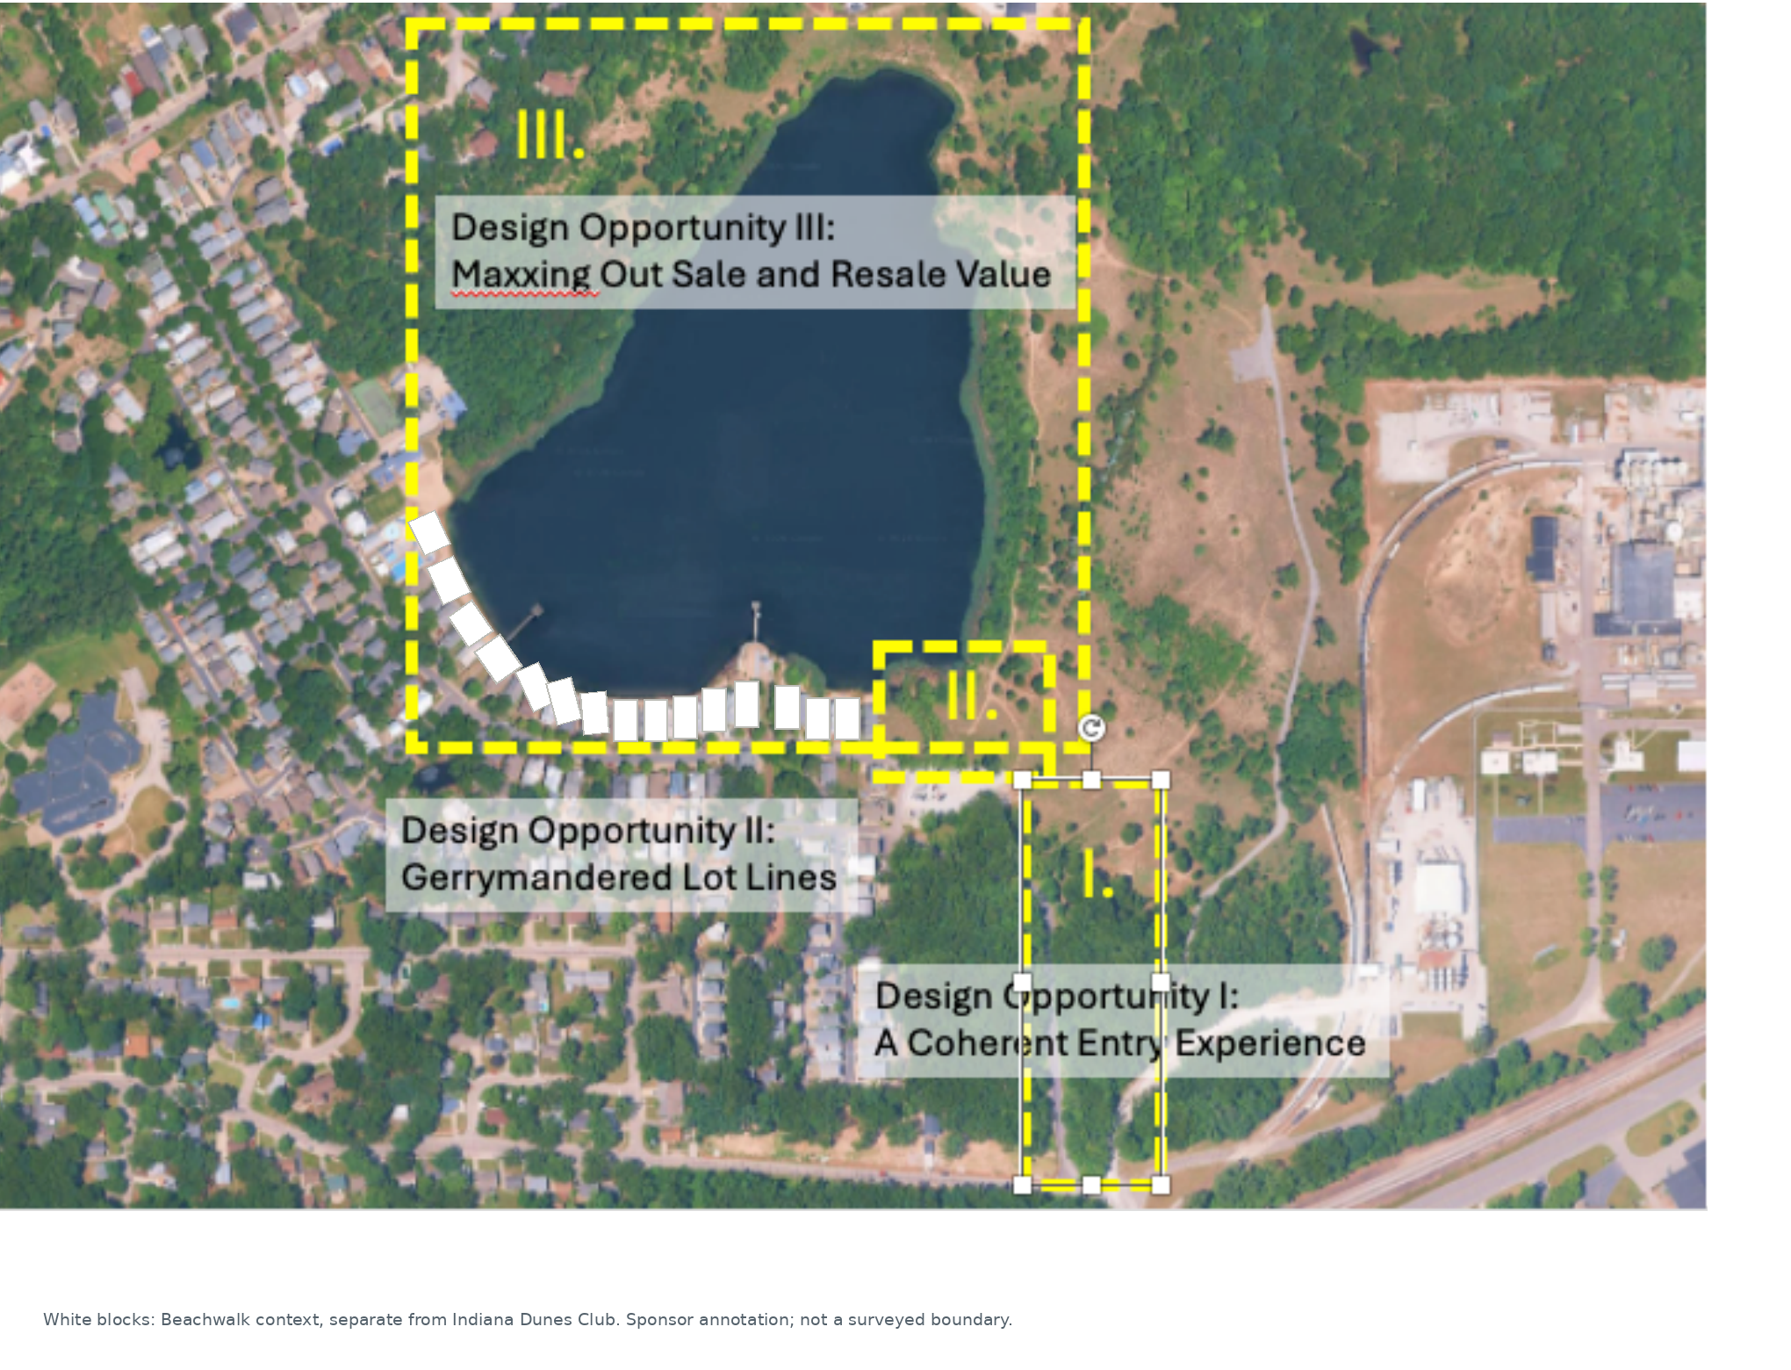
SOLO INVESTOR / OCTOBER 13, 2026
One active schedule: 50 months
January 2027 through February 2031. There is no active 36-month alternative.
Year
Contracts
Closings
Development uses
Net cash
2027
16
0
$1,819,250
−$1,819,250
2028
24
0
$9,484,309
−$9,484,309
2029
24
60
$315,398
$22,594,559
2030
24
24
$81,307
$9,120,859
2031
0
4
$237
$1,539,848
88 contracts and 88 closings reconcile to the product mix.
Sponsor planning assumptions. Not an offer, guaranteed return, appraisal or approval.
Source cells: SUMMARY!G6:G10; Proforma!BH:BL
https://indianadunesclub.pplx.app/downloads/Indiana-Dunes-Club-Financials-and-Proforma.xlsx
7
Notes:
Current source: corrected October 13, 2026 workbook. SUMMARY!G6:G10; Proforma!BH:BL. https://indianadunesclub.pplx.app/downloads/Indiana-Dunes-Club-Financials-and-Proforma.xlsx
All figures are sponsor planning assumptions. Preserve separate horizontal and vertical scopes. Acquisition=0 is not verified free land. Investor terms and legal/tax eligibility require confirmation.

Slide 8
SOLO INVESTOR / OCTOBER 13, 2026
Absorption and funding are assumptions to test
The backlog release materially affects the modeled timing.
CONTRACTS
FIRST CLOSINGS
PEAK MODELED EQUITY
2 / month
38 homes
$11.30M
Begin May 2027 and run through December 2030.
January 2029 releases the modeled backlog, then two closings monthly.
Before financing and unmodeled costs. Not a final capital raise.
Sponsor planning assumptions. Not an offer, guaranteed return, appraisal or approval.
Source cells: Proforma!F:BC; SUMMARY!K41
https://indianadunesclub.pplx.app/downloads/Indiana-Dunes-Club-Financials-and-Proforma.xlsx
8
Notes:
Current source: corrected October 13, 2026 workbook. Proforma!F:BC; SUMMARY!K41. https://indianadunesclub.pplx.app/downloads/Indiana-Dunes-Club-Financials-and-Proforma.xlsx
All figures are sponsor planning assumptions. Preserve separate horizontal and vertical scopes. Acquisition=0 is not verified free land. Investor terms and legal/tax eligibility require confirmation.

Slide 9
SOLO INVESTOR / OCTOBER 13, 2026
Base product value differs from timed lot sales
Both views use the same product inputs, but they answer different questions.
PRODUCT ALLOCATION
TIMED GROSS SALES
DIFFERENCE
$35.45M
$35.80M
$350,221
Un-escalated total across the 10 rows. Used by the interactive assumptions tool.
Workbook monthly timing and price-growth conventions.
Timing / growth effect, not additional units or a second price schedule.
Sponsor planning assumptions. Not an offer, guaranteed return, appraisal or approval.
Source cells: Lot Pricing Worksheet!G12; SUMMARY!K25
https://indianadunesclub.pplx.app/downloads/Indiana-Dunes-Club-Financials-and-Proforma.xlsx
9
Notes:
Current source: corrected October 13, 2026 workbook. Lot Pricing Worksheet!G12; SUMMARY!K25. https://indianadunesclub.pplx.app/downloads/Indiana-Dunes-Club-Financials-and-Proforma.xlsx
All figures are sponsor planning assumptions. Preserve separate horizontal and vertical scopes. Acquisition=0 is not verified free land. Investor terms and legal/tax eligibility require confirmation.

Slide 10
SOLO INVESTOR / OCTOBER 13, 2026
Illinois starts with one home, not a $6M example
Lowest source allocation: Big House Condo. Other home types remain selectable.
Starting input
Amount / basis
Homes
1
Allocated land
$225,000
Home size / construction rate
900 SF × $350/SF
Construction allowance
$315,000
Base land + construction subtotal
$540,000
Condo land allocation is not confirmation of a purchasable fee-simple lot.
Sponsor planning assumptions. Not an offer, guaranteed return, appraisal or approval.
Source cells: Lot Pricing Worksheet!row 5
https://indianadunesclub.pplx.app/downloads/Indiana-Dunes-Club-Financials-and-Proforma.xlsx
10
Notes:
Current source: corrected October 13, 2026 workbook. Lot Pricing Worksheet!row 5. https://indianadunesclub.pplx.app/downloads/Indiana-Dunes-Club-Financials-and-Proforma.xlsx
All figures are sponsor planning assumptions. Preserve separate horizontal and vertical scopes. Acquisition=0 is not verified free land. Investor terms and legal/tax eligibility require confirmation.

Slide 11
SOLO INVESTOR / OCTOBER 13, 2026
The one-home subtotal is not all-in capital
Unconfirmed allowances are blank in the calculator, not assumed to be free.
Construction extras
Design, permits, soft costs and a construction contingency require project-specific allowances.
Acquisition and fit-out
Confirm closing costs, furnishing, equipment, financing, carrying costs and reserves.
Income and tax
No rent, operator guarantee, depreciation benefit, tax savings or tax-free exit is modeled.
Sponsor planning assumptions. Not an offer, guaranteed return, appraisal or approval.
Source cells: Lot Pricing Worksheet; SUMMARY scope limitations
https://indianadunesclub.pplx.app/downloads/Indiana-Dunes-Club-Financials-and-Proforma.xlsx
11
Notes:
Current source: corrected October 13, 2026 workbook. Lot Pricing Worksheet; SUMMARY scope limitations. https://indianadunesclub.pplx.app/downloads/Indiana-Dunes-Club-Financials-and-Proforma.xlsx
All figures are sponsor planning assumptions. Preserve separate horizontal and vertical scopes. Acquisition=0 is not verified free land. Investor terms and legal/tax eligibility require confirmation.

Slide 12
SOLO INVESTOR / OCTOBER 13, 2026
Reconcile acreage before a definitive land claim
The workbook basis differs from prior rounded marketing acreage.
WORKBOOK TOTAL
PRIOR MARKETING
REQUIRED DILIGENCE
40.806 acres
About 43 acres
Survey + title
23.930 lake acres plus 16.876 upland acres.
Approximately 26 lake + 17 upland. Not silently substituted into the model.
Reconcile parcel boundaries, ownership, lake rights and approved unit count.
Sponsor planning assumptions. Not an offer, guaranteed return, appraisal or approval.
Source cells: SUMMARY!K9:K11
https://indianadunesclub.pplx.app/downloads/Indiana-Dunes-Club-Financials-and-Proforma.xlsx
12
Notes:
Current source: corrected October 13, 2026 workbook. SUMMARY!K9:K11. https://indianadunesclub.pplx.app/downloads/Indiana-Dunes-Club-Financials-and-Proforma.xlsx
All figures are sponsor planning assumptions. Preserve separate horizontal and vertical scopes. Acquisition=0 is not verified free land. Investor terms and legal/tax eligibility require confirmation.

Slide 13
SOLO INVESTOR / OCTOBER 13, 2026
Investor terms and OZ outcomes remain conditional
The financial model is not an offering document, legal opinion or investor waterfall.
Capital and distributions
Confirm land contribution / buyout, debt, fees, funding obligations and distribution priorities.
Operator and approvals
Obtain executed agreements, current entitlements, construction pricing and an absorption review.
OZ / Illinois treatment
Counsel must confirm tract status, entity and investor eligibility, timing, compliance and state treatment.
Sponsor planning assumptions. Not an offer, guaranteed return, appraisal or approval.
Source cells: SUMMARY; Proforma; Lot Pricing Worksheet
https://indianadunesclub.pplx.app/downloads/Indiana-Dunes-Club-Financials-and-Proforma.xlsx
13
Notes:
Current source: corrected October 13, 2026 workbook. SUMMARY; Proforma; Lot Pricing Worksheet. https://indianadunesclub.pplx.app/downloads/Indiana-Dunes-Club-Financials-and-Proforma.xlsx
All figures are sponsor planning assumptions. Preserve separate horizontal and vertical scopes. Acquisition=0 is not verified free land. Investor terms and legal/tax eligibility require confirmation.

Slide 14
SOLO INVESTOR / OCTOBER 13, 2026
Open the current model; underwrite the unresolved items
The workbook remains unchanged. Scenario edits do not rewrite source assumptions.
Choose a model
Solo Investor starts with 88 homes. Illinois OZ Investor starts with one home and the lowest source allocation.
Review the source
Use the corrected workbook, current pro forma and the 50-month schedule. Historical materials are labeled separately.
Discuss the next step
Request current land terms, approvals, bids, financing and offering documentation from the project team.
indianadunesclub.com | indianadunesclub.pplx.app
Sponsor planning assumptions. Not an offer, guaranteed return, appraisal or approval.
Source cells: SUMMARY; Proforma; Lot Pricing Worksheet
https://indianadunesclub.pplx.app/downloads/Indiana-Dunes-Club-Financials-and-Proforma.xlsx
14
Notes:
Current source: corrected October 13, 2026 workbook. SUMMARY; Proforma; Lot Pricing Worksheet. https://indianadunesclub.pplx.app/downloads/Indiana-Dunes-Club-Financials-and-Proforma.xlsx
All figures are sponsor planning assumptions. Preserve separate horizontal and vertical scopes. Acquisition=0 is not verified free land. Investor terms and legal/tax eligibility require confirmation.

