Slide 1




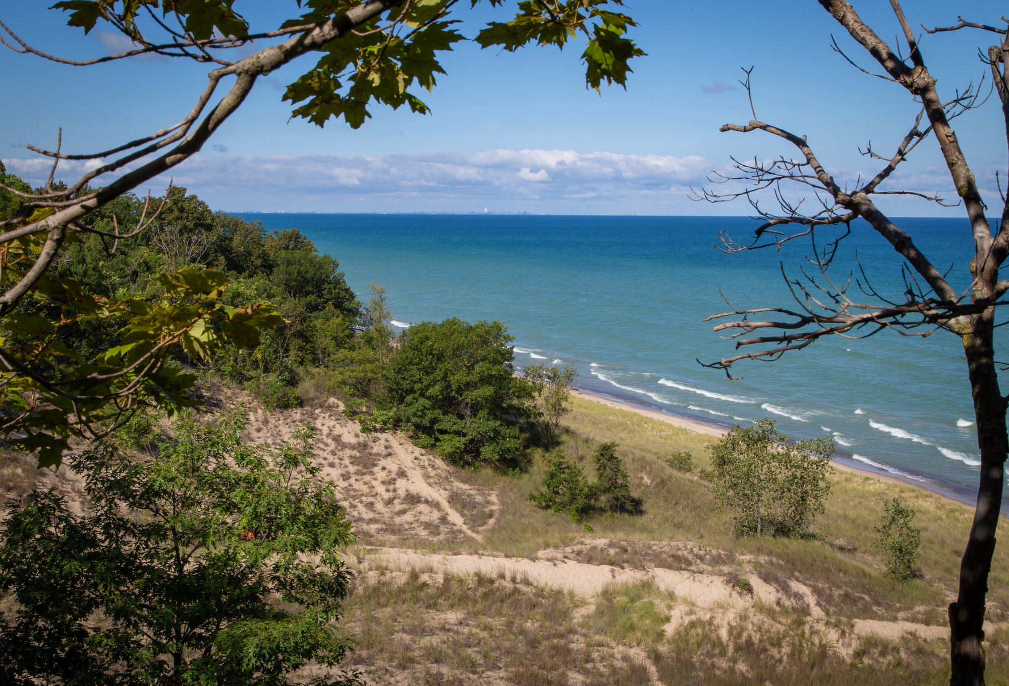
ILLINOIS INVESTOR / ONE TO FIVE LOTS & HOMES
Illinois Investor
One to five lots & homes at Indiana Dunes Club
A property-level investment.
Not a whole-community capital raise.
Select the homes you want to own. Underwrite their complete costs, income and exit. Evaluate Opportunity Zone treatment separately with your advisers.
Illustrative architecture; not a specific lot or quoted home.
Sponsor planning assumptions. Subject to availability, title, approvals and definitive agreements.
Source: Lot Pricing Worksheet!A2:P12
https://indianadunesclub.pplx.app/downloads/Indiana-Dunes-Club-Financials-and-Proforma.xlsx
1 / 14
Notes:
Illinois investor edition, one to five proposed lots and homes. Corrected October13,2026 workbook unchanged. Source: Lot Pricing Worksheet!A2:P12. URL: https://indianadunesclub.pplx.app/downloads/Indiana-Dunes-Club-Financials-and-Proforma.xlsx. These are sponsor inputs, not quoted lot inventory or contractor bids. No whole-project funding or horizontal return figures belong in this deck.

Slide 2

ILLINOIS INVESTOR / ONE TO FIVE LOTS & HOMES
Your investment is the selected properties
The proposed community provides context. Your economics remain specific to the lots and homes you acquire.
ACQUIRE
OWN & OPERATE
HOLD OR EXIT
1–5 lots
Your portfolio
Your decision
Choose a documented lot/home package, title structure and approved build scope.
Receive the selected properties’ operating cash flow, less agreed costs and any debt service.
Underwrite resale, refinancing and hold duration; tax treatment may constrain the timing.
Sponsor planning assumptions. Subject to availability, title, approvals and definitive agreements.
Source: Lot Pricing Worksheet!A2:P12
https://indianadunesclub.pplx.app/downloads/Indiana-Dunes-Club-Financials-and-Proforma.xlsx
2 / 14
Notes:
Illinois investor edition, one to five proposed lots and homes. Corrected October13,2026 workbook unchanged. Source: Lot Pricing Worksheet!A2:P12. URL: https://indianadunesclub.pplx.app/downloads/Indiana-Dunes-Club-Financials-and-Proforma.xlsx. These are sponsor inputs, not quoted lot inventory or contractor bids. No whole-project funding or horizontal return figures belong in this deck. This deck intentionally excludes sponsor-wide horizontal budget, sellout proceeds, peak project equity and whole-project cash flow. 88-home program size is background only, not a proportionate investment interest.

Slide 3
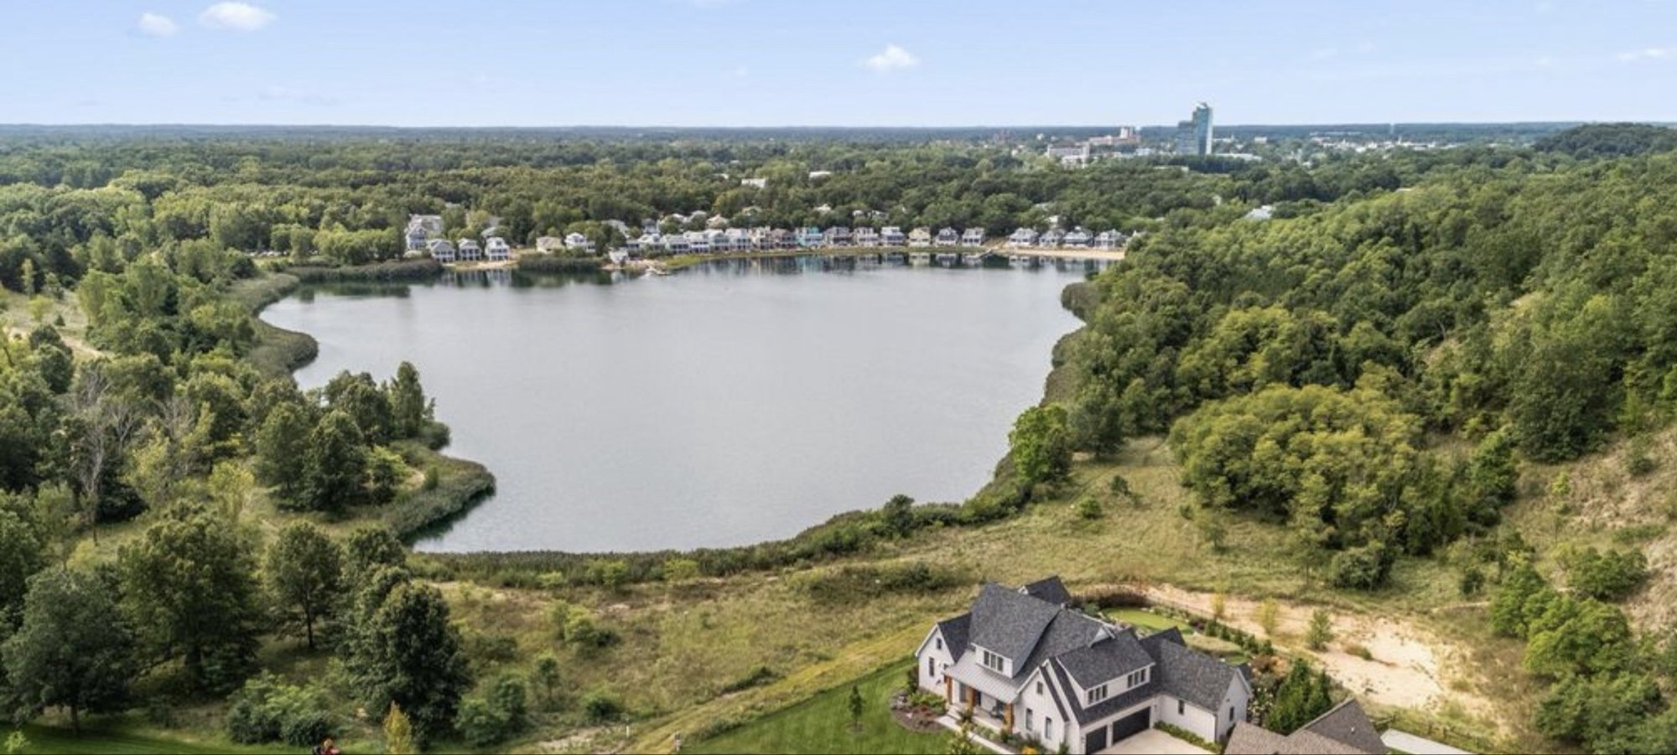
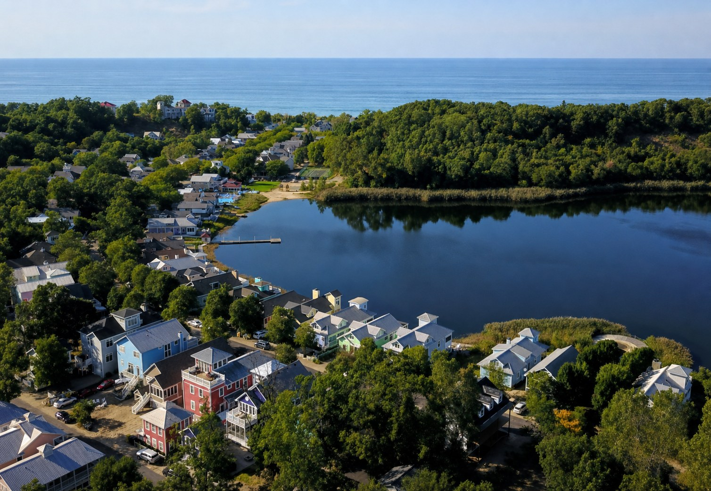
ILLINOIS INVESTOR / ONE TO FIVE LOTS & HOMES
A small portfolio in a proposed lakeside community
Michigan City, Indiana. The sponsor’s 88-home concept is the setting, not the investor’s purchase quantity.
Select for the use case
Home size and guest profile
Rental rules and personal-use limits
Access, parking and amenity rights
Management and resale strategy
Sponsor planning assumptions. Subject to availability, title, approvals and definitive agreements.
Source: Lot Pricing Worksheet!A2:P12
https://indianadunesclub.pplx.app/downloads/Indiana-Dunes-Club-Financials-and-Proforma.xlsx
3 / 14
Notes:
Illinois investor edition, one to five proposed lots and homes. Corrected October13,2026 workbook unchanged. Source: Lot Pricing Worksheet!A2:P12. URL: https://indianadunesclub.pplx.app/downloads/Indiana-Dunes-Club-Financials-and-Proforma.xlsx. These are sponsor inputs, not quoted lot inventory or contractor bids. No whole-project funding or horizontal return figures belong in this deck. Existing sponsor aerial photograph. Concept count is not certification of final plat or available inventory. Physical lot selection and rental permissions require sponsor and legal confirmation.

Slide 4
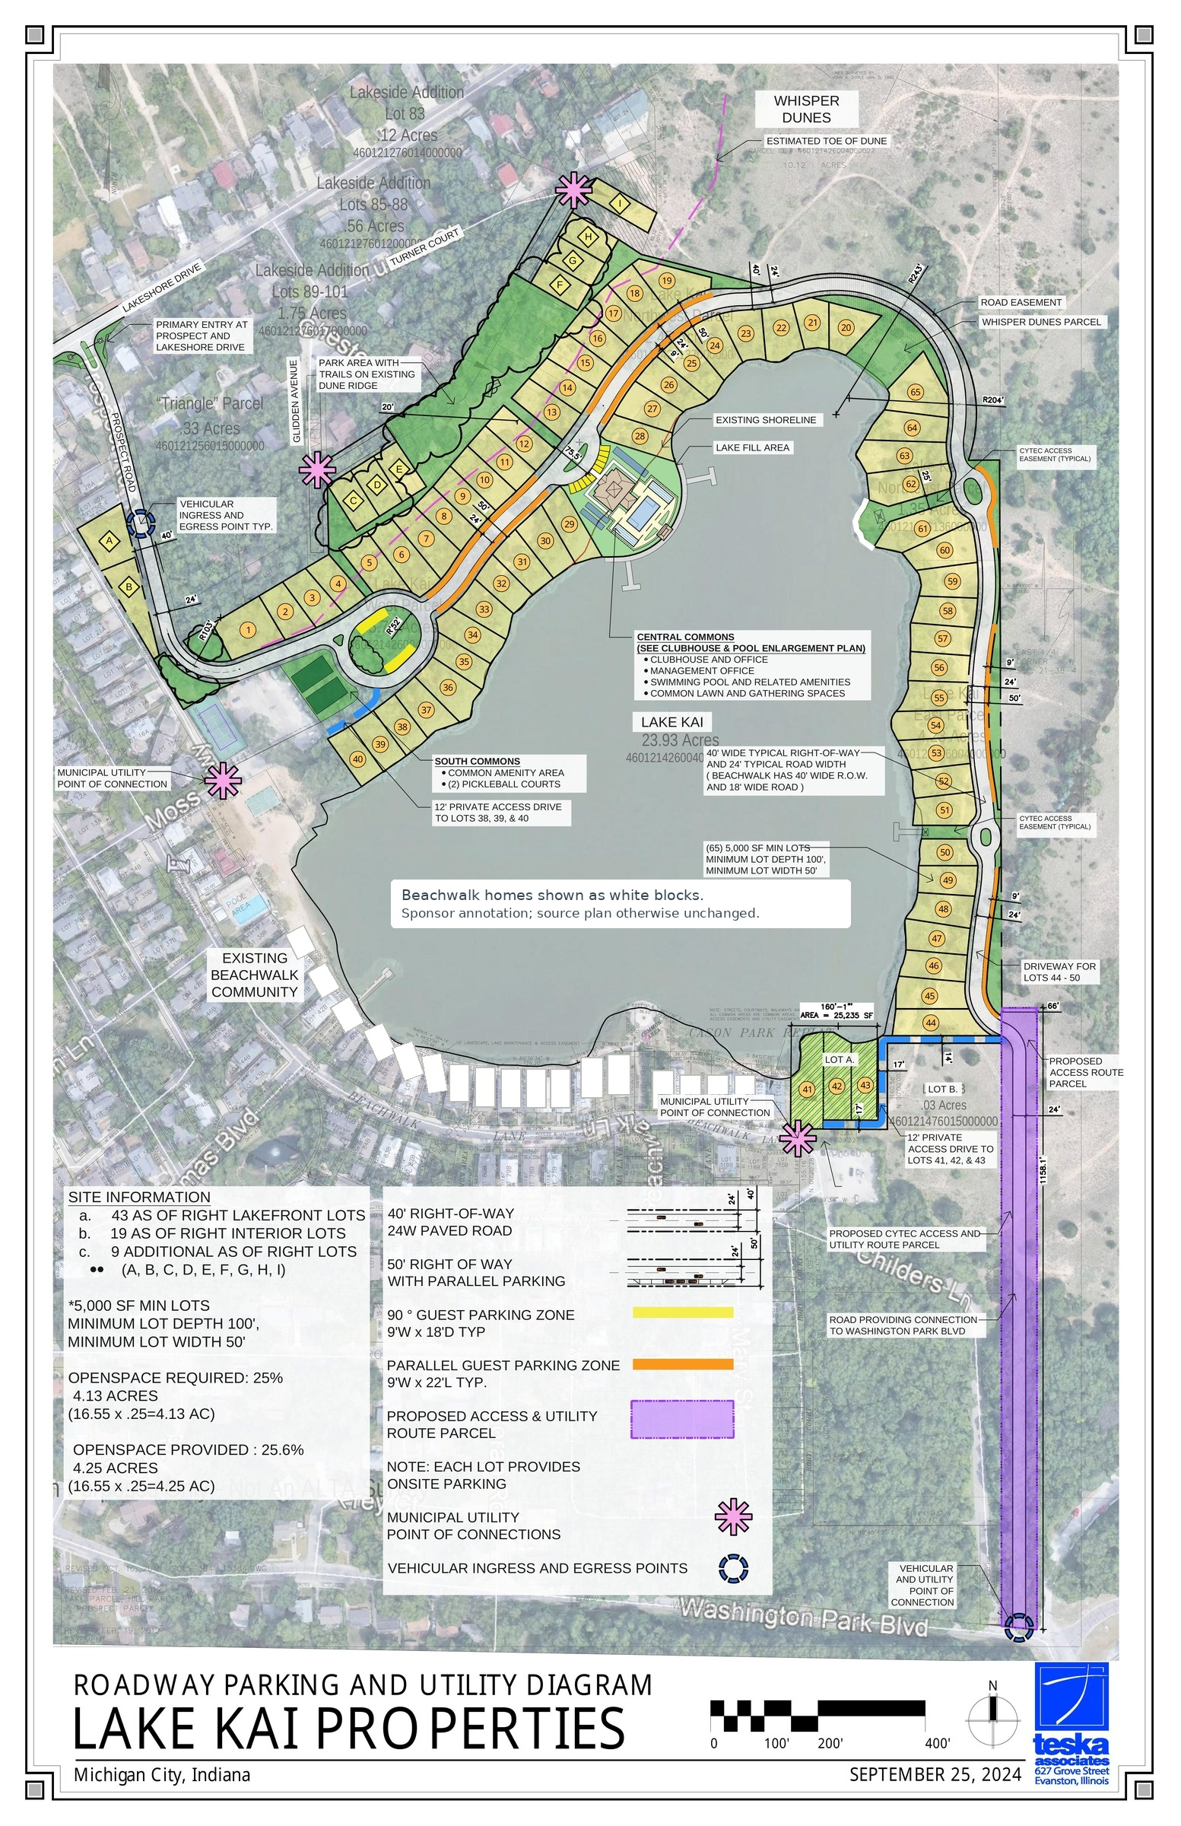
ILLINOIS INVESTOR / ONE TO FIVE LOTS & HOMES
Lot-based options from the source workbook
Per-home planning allocations and construction allowances. Counts shown are concept totals, not live availability.
Product
Concept homes
Lot allocation
Construction
Base subtotal
Treehouses
4
$250,000
$385,000
$635,000
Court Homes
6
$300,000
$525,000
$825,000
Pool Bungalows
9
$300,000
$560,000
$860,000
Dune Homes
9
$400,000
$945,000
$1,345,000
Lake Cottages (6 pack)
24
$450,000
$735,000
$1,185,000
Lake Cottages (4 pack)
8
$450,000
$822,500
$1,272,500
Crescent Homes
8
$500,000
$980,000
$1,480,000
Manor Homes
5
$600,000
$1,085,000
$1,685,000
Forest Homes
3
$750,000
$1,260,000
$2,010,000
Condo alternative (not a stand-alone lot): $225,000 land + $315,000 build = $540,000.
Sponsor planning assumptions. Subject to availability, title, approvals and definitive agreements.
Source: Lot Pricing Worksheet!A2:P12
https://indianadunesclub.pplx.app/downloads/Indiana-Dunes-Club-Financials-and-Proforma.xlsx
4 / 14
Notes:
Illinois investor edition, one to five proposed lots and homes. Corrected October13,2026 workbook unchanged. Source: Lot Pricing Worksheet!A2:P12. URL: https://indianadunesclub.pplx.app/downloads/Indiana-Dunes-Club-Financials-and-Proforma.xlsx. These are sponsor inputs, not quoted lot inventory or contractor bids. No whole-project funding or horizontal return figures belong in this deck.

Slide 5
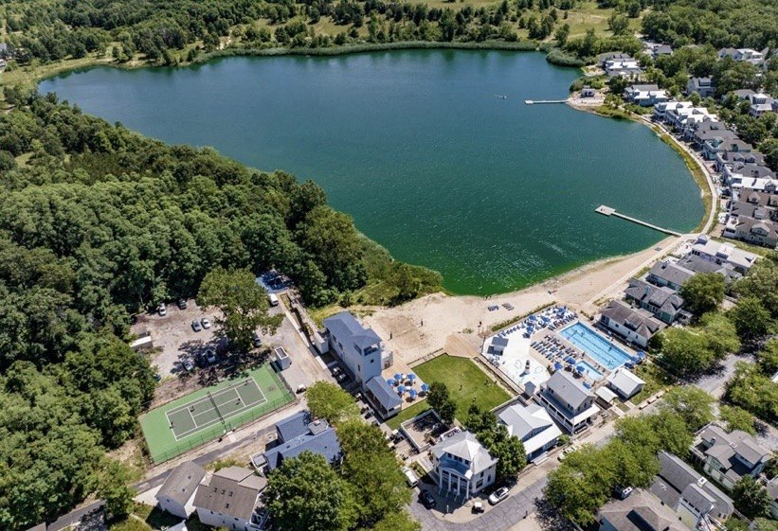
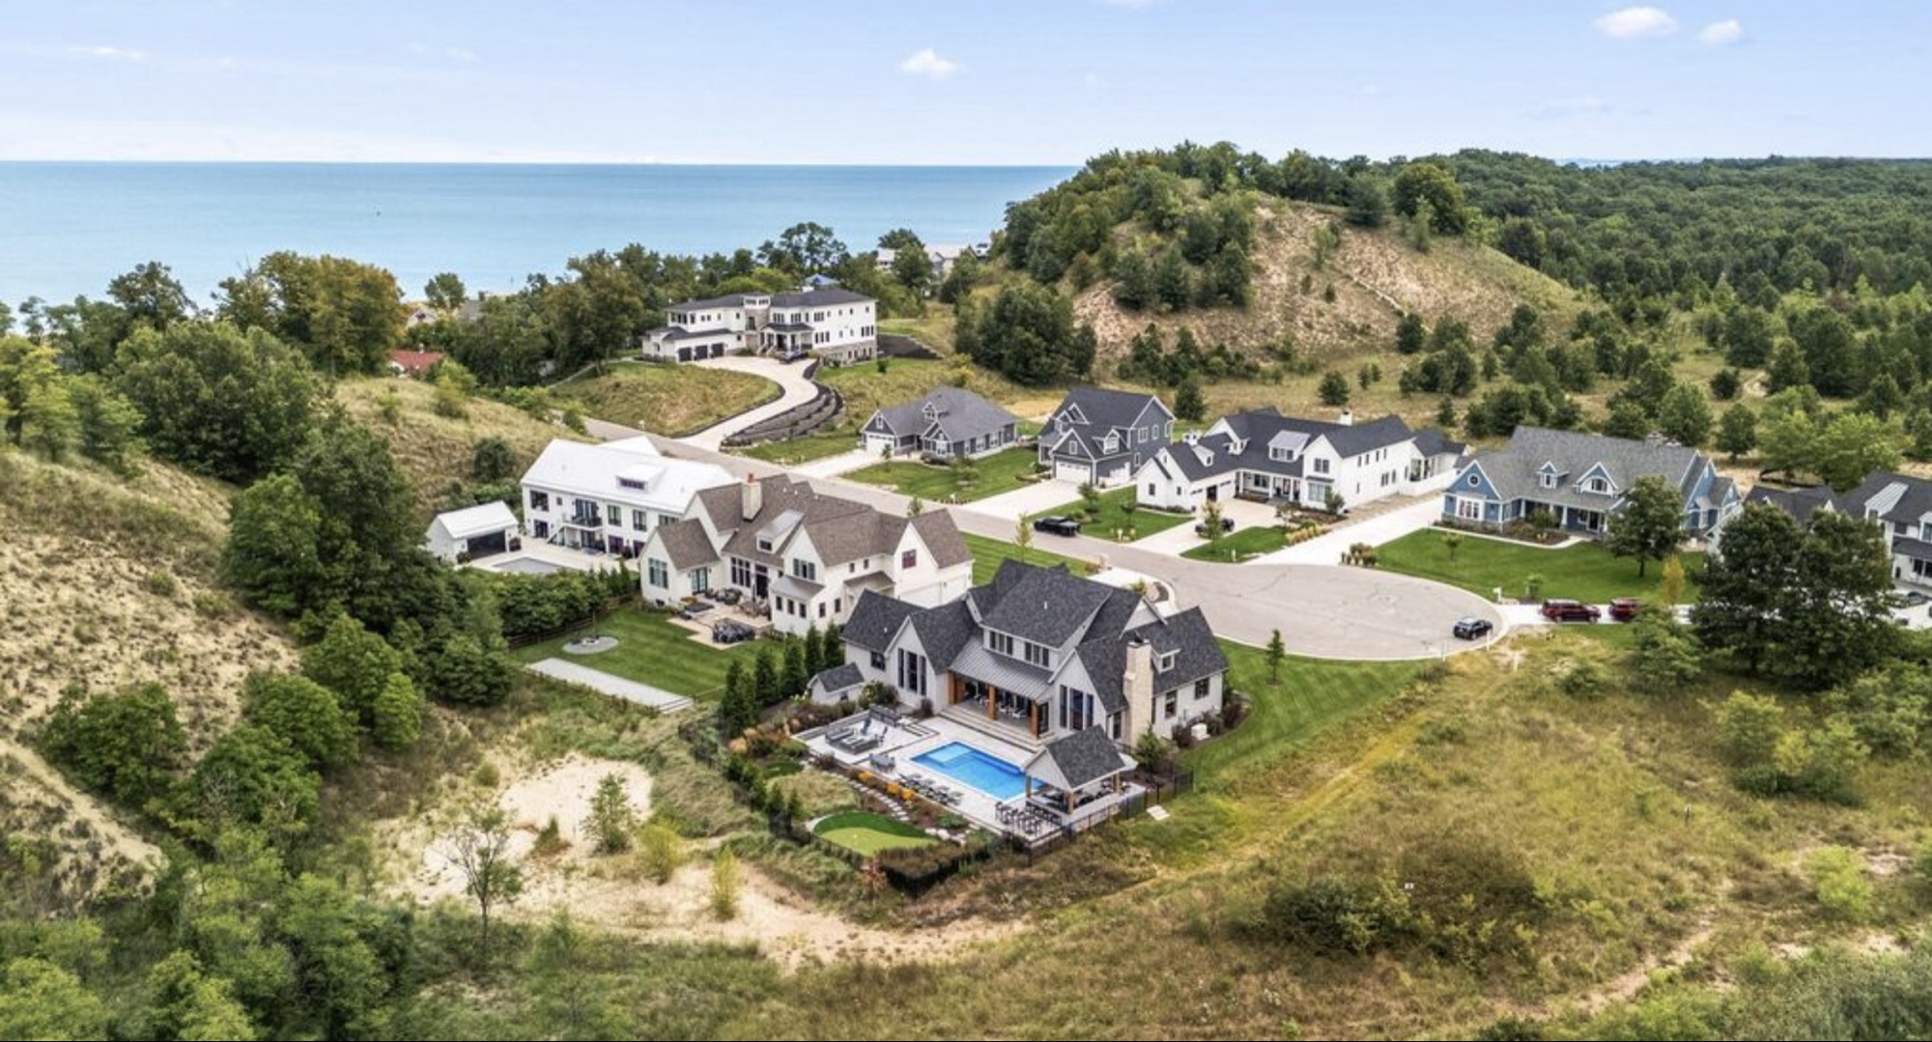
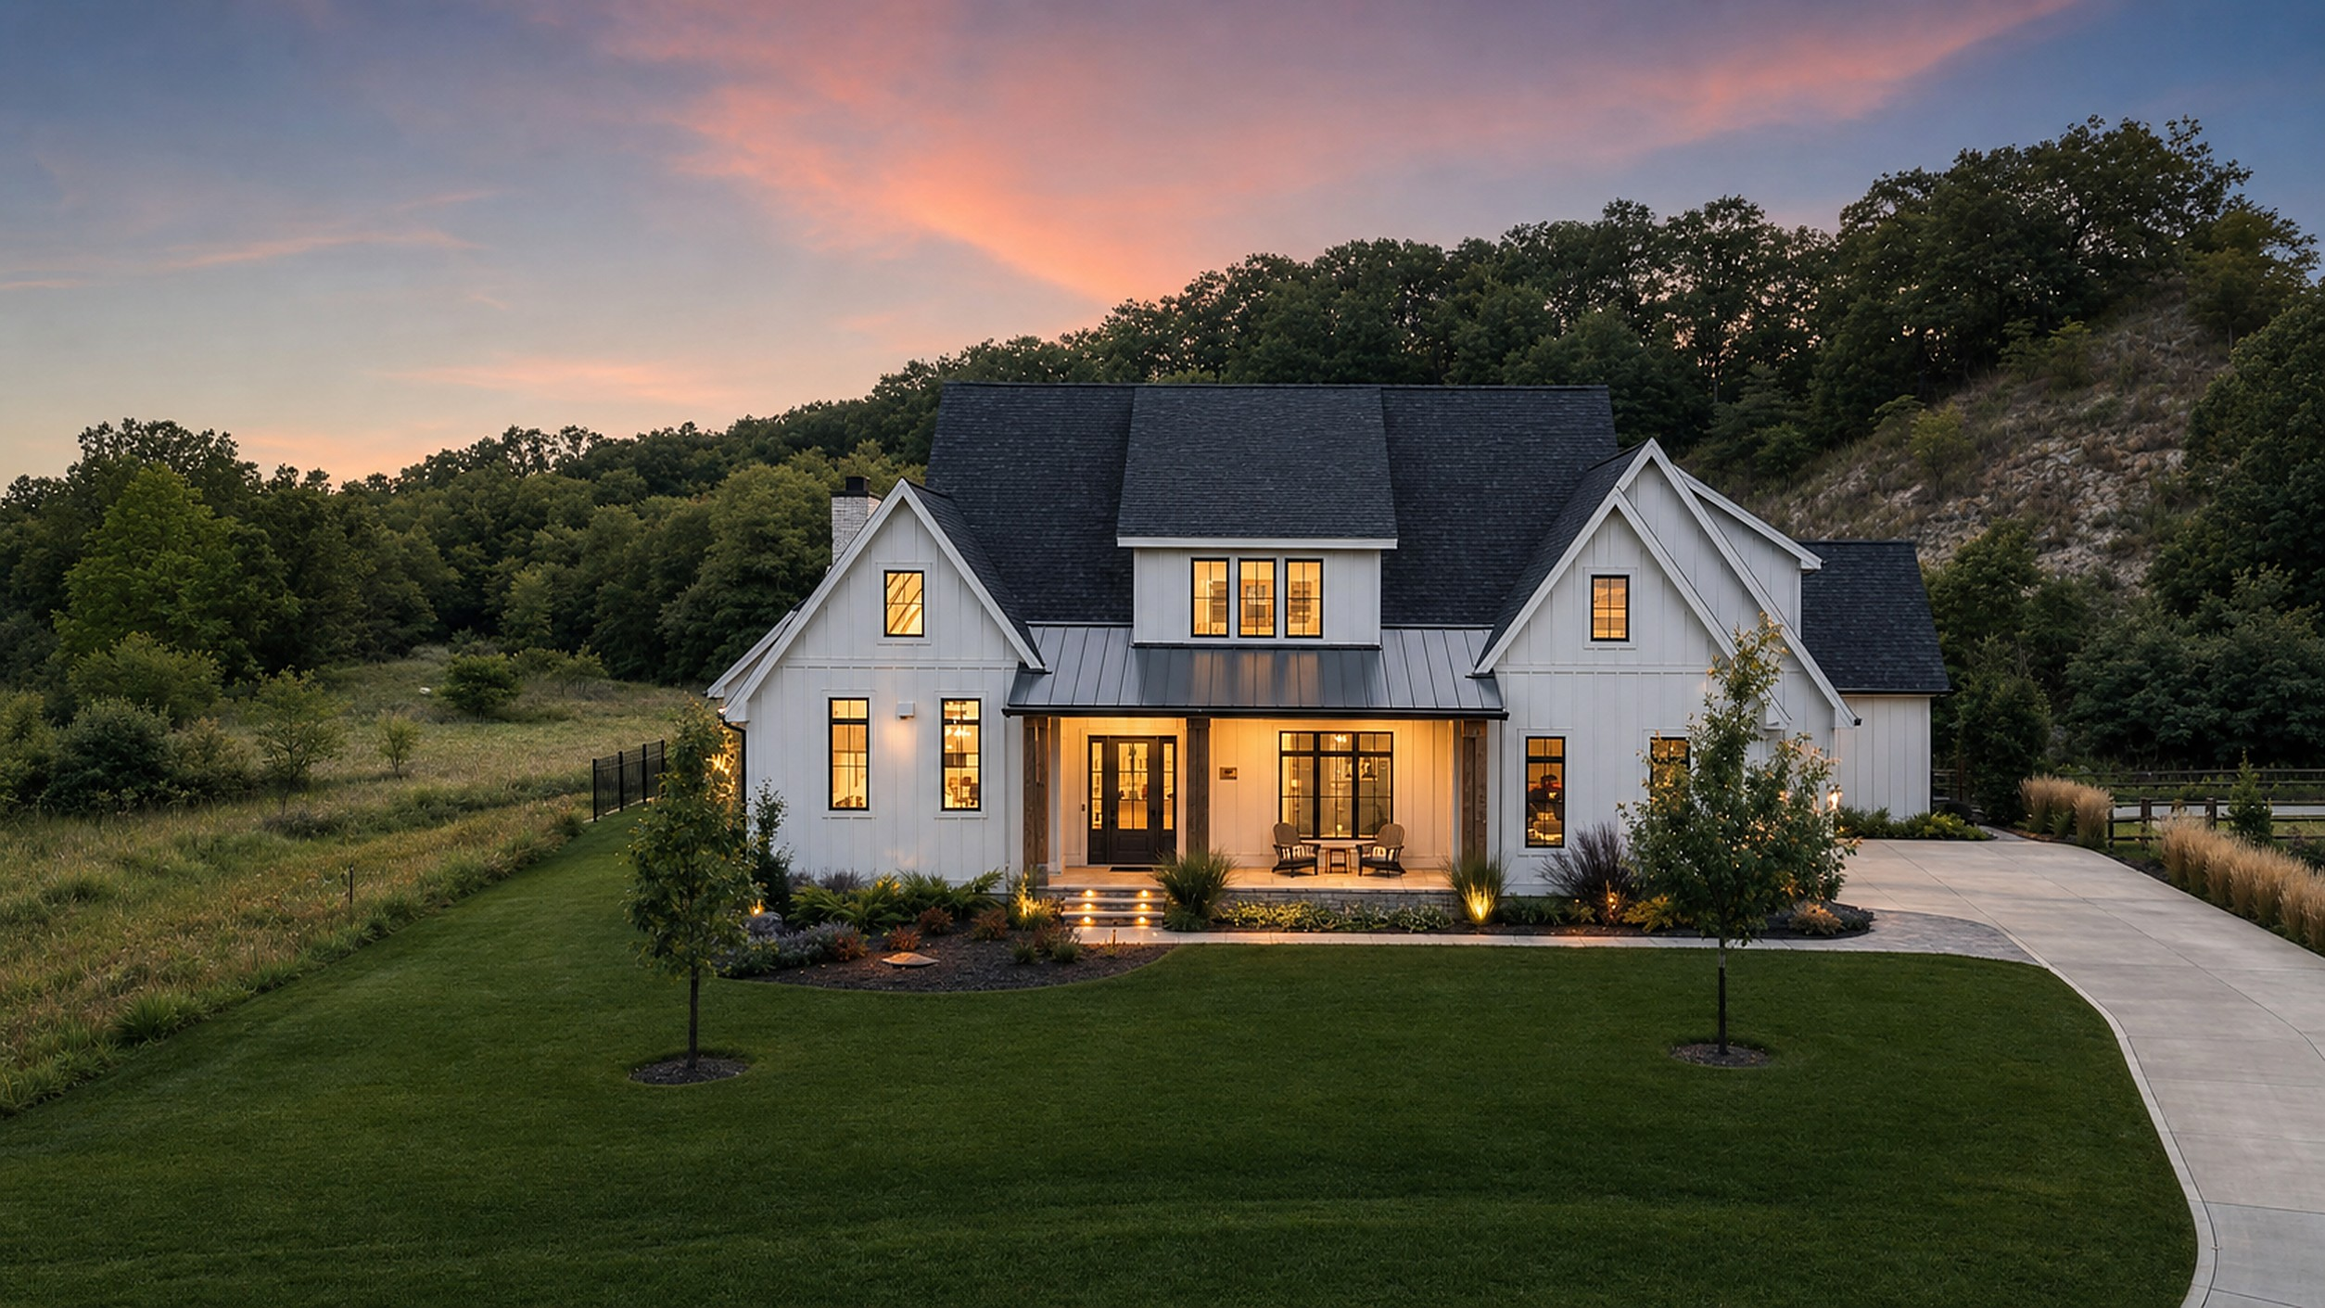
ILLINOIS INVESTOR / ONE TO FIVE LOTS & HOMES
Entry-price route: one through five properties
Lowest non-condo source allocation: Treehouse. The fifth property explicitly changes the mix.
Lots
Illustrative mix
Lot allocations
Construction
Base subtotal
1
1 Treehouse
$250,000
$385,000
$635,000
2
2 Treehouses
$500,000
$770,000
$1,270,000
3
3 Treehouses
$750,000
$1,155,000
$1,905,000
4
4 Treehouses
$1,000,000
$1,540,000
$2,540,000
5
4 Treehouses + 1 Court
$1,300,000
$2,065,000
$3,365,000
Only four Treehouses appear in the source plan. The five-property case adds one Court Home; no fifth Treehouse or bulk discount is assumed.
Sponsor planning assumptions. Subject to availability, title, approvals and definitive agreements.
Source: Lot Pricing Worksheet!row 6 (Treehouses) and row 3 (Court Homes)
https://indianadunesclub.pplx.app/downloads/Indiana-Dunes-Club-Financials-and-Proforma.xlsx
5 / 14
Notes:
Illinois investor edition, one to five proposed lots and homes. Corrected October13,2026 workbook unchanged. Source: Lot Pricing Worksheet!row 6 (Treehouses) and row 3 (Court Homes). URL: https://indianadunesclub.pplx.app/downloads/Indiana-Dunes-Club-Financials-and-Proforma.xlsx. These are sponsor inputs, not quoted lot inventory or contractor bids. No whole-project funding or horizontal return figures belong in this deck.

Slide 6
ILLINOIS INVESTOR / ONE TO FIVE LOTS & HOMES
Like-for-like route: one to five Court Homes
Each Court Home: $300,000 lot allocation + 1,500 SF × $350/SF = $825,000 base subtotal.
Lots
Total lot allocations
Total construction
Base subtotal
1
$300,000
$525,000
$825,000
2
$600,000
$1,050,000
$1,650,000
3
$900,000
$1,575,000
$2,475,000
4
$1,200,000
$2,100,000
$3,300,000
5
$1,500,000
$2,625,000
$4,125,000
Six Court Homes appear in the concept plan. A one-to-five selection still requires confirmation of availability and legal lot structure.
Sponsor planning assumptions. Subject to availability, title, approvals and definitive agreements.
Source: Lot Pricing Worksheet!B3, F3, I3, K3, L3
https://indianadunesclub.pplx.app/downloads/Indiana-Dunes-Club-Financials-and-Proforma.xlsx
6 / 14
Notes:
Illinois investor edition, one to five proposed lots and homes. Corrected October13,2026 workbook unchanged. Source: Lot Pricing Worksheet!B3, F3, I3, K3, L3. URL: https://indianadunesclub.pplx.app/downloads/Indiana-Dunes-Club-Financials-and-Proforma.xlsx. These are sponsor inputs, not quoted lot inventory or contractor bids. No whole-project funding or horizontal return figures belong in this deck.

Slide 7
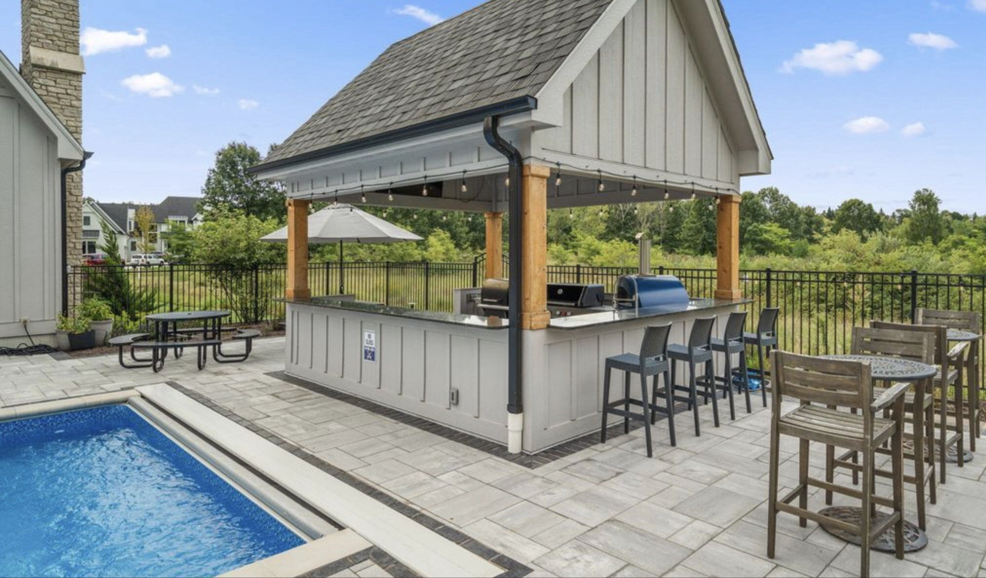
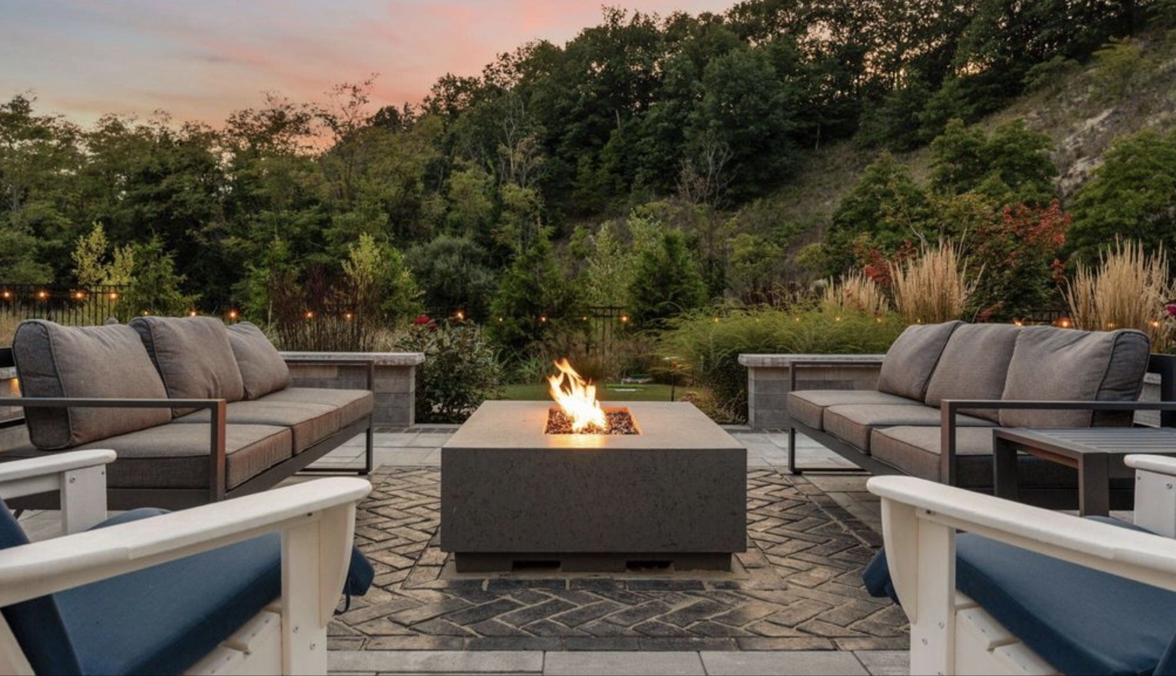
ILLINOIS INVESTOR / ONE TO FIVE LOTS & HOMES
Base pricing is not the full investment requirement
A complete quote needs the selected properties’ actual scope, fees, financing and reserves.
COURT HOME EXAMPLE
ADDITIONAL USES
EQUITY REQUIREMENT
$825,000
To be priced
To be sized
Allocated land plus construction only. No quoted contingency or furnishing allowance is embedded.
Closing, design, permits, fees, contingency, fit-out, financing, carrying costs and operating reserves.
Confirmed total uses less committed debt, adjusted for timing. Property cost is not automatically eligible gain.
Sponsor planning assumptions. Subject to availability, title, approvals and definitive agreements.
Source: Lot Pricing Worksheet!row 3; additional items are underwriting requirements, not source estimates
https://indianadunesclub.pplx.app/downloads/Indiana-Dunes-Club-Financials-and-Proforma.xlsx
7 / 14
Notes:
Illinois investor edition, one to five proposed lots and homes. Corrected October13,2026 workbook unchanged. Source: Lot Pricing Worksheet!row 3; additional items are underwriting requirements, not source estimates. URL: https://indianadunesclub.pplx.app/downloads/Indiana-Dunes-Club-Financials-and-Proforma.xlsx. These are sponsor inputs, not quoted lot inventory or contractor bids. No whole-project funding or horizontal return figures belong in this deck.

Slide 8
ILLINOIS INVESTOR / ONE TO FIVE LOTS & HOMES
Underwrite rental income before assuming a return
Illustrative NOI targets only: these are required earnings, not forecasts, lease quotes or guaranteed yields.
Illustrative NOI / base cost
Annual NOI: 1 home
Annual NOI: 5 homes
5%
$41,250
$206,250
6%
$49,500
$247,500
7%
$57,750
$288,750
NOI is after property operating expenses but before debt service and investor income taxes. Adding the unconfirmed costs increases the NOI needed for the same yield.
Sponsor planning assumptions. Subject to availability, title, approvals and definitive agreements.
Source: Calculated sensitivity using Court Home base subtotal ($825,000); yield inputs chosen for illustration
https://indianadunesclub.pplx.app/downloads/Indiana-Dunes-Club-Financials-and-Proforma.xlsx
8 / 14
Notes:
Illinois investor edition, one to five proposed lots and homes. Corrected October13,2026 workbook unchanged. Source: Calculated sensitivity using Court Home base subtotal ($825,000); yield inputs chosen for illustration. URL: https://indianadunesclub.pplx.app/downloads/Indiana-Dunes-Club-Financials-and-Proforma.xlsx. These are sponsor inputs, not quoted lot inventory or contractor bids. No whole-project funding or horizontal return figures belong in this deck. At5%:41250/206250. At6%:49500/247500. At7%:57750/288750. The denominator is an incomplete base cost, so this is not an all-in yield. No market rent, occupancy or operator covenant is established.

Slide 9
ILLINOIS INVESTOR / ONE TO FIVE LOTS & HOMES
Delivery and operations need written terms
Sponsor-led coordination is a proposed service model, not a substitute for an executed agreement.
Design & build
Approve the selected plan, specifications, fixed-price or other contract, draw milestones, contingency and completion obligations.
Rental operations
Verify permissions, operator experience, management fees, operating budget, reserves, owner-use limits and reporting.
Portfolio control
Confirm HOA charges, amenity and lake rights, insurance, maintenance responsibilities, transfer restrictions and exit rights.
Sponsor planning assumptions. Subject to availability, title, approvals and definitive agreements.
Source: Investor diligence framework; current lot/construction inputs: Lot Pricing Worksheet
https://indianadunesclub.pplx.app/downloads/Indiana-Dunes-Club-Financials-and-Proforma.xlsx
9 / 14
Notes:
Illinois investor edition, one to five proposed lots and homes. Corrected October13,2026 workbook unchanged. Source: Investor diligence framework; current lot/construction inputs: Lot Pricing Worksheet. URL: https://indianadunesclub.pplx.app/downloads/Indiana-Dunes-Club-Financials-and-Proforma.xlsx. These are sponsor inputs, not quoted lot inventory or contractor bids. No whole-project funding or horizontal return figures belong in this deck.

Slide 10
ILLINOIS INVESTOR / ONE TO FIVE LOTS & HOMES
OZ participation is a structure, not a deed feature
Conceptual route for counsel to confirm. Buying a lot directly does not by itself establish a qualifying QOF investment.
INVESTOR
VEHICLE
ASSETS
Eligible gain
QOF / QOZB
1–5 properties
Confirm taxpayer, gain amount and investment deadline; general timing is 180 days, subject to applicable rules.
Counsel designs the investor vehicle and qualifying property/business structure, with ongoing testing and reporting.
The selected lots and homes sit within the documented structure; no automatic tax benefit attaches to the purchase price.
Sponsor planning assumptions. Subject to availability, title, approvals and definitive agreements.
Source: IRS: Opportunity Zones; IRS Notice 2026-40, §4
https://www.irs.gov/pub/irs-drop/n-26-40.pdf
10 / 14
Notes:
Illinois investor edition, one to five proposed lots and homes. Corrected October13,2026 workbook unchanged. Source: IRS: Opportunity Zones; IRS Notice 2026-40, §4. URL: https://www.irs.gov/pub/irs-drop/n-26-40.pdf. These are sponsor inputs, not quoted lot inventory or contractor bids. No whole-project funding or horizontal return figures belong in this deck. The investor-controlled QOF/QOZB concept is subject to legal/tax confirmation, not an established offering. IRS general overview: https://www.irs.gov/credits-deductions/businesses/opportunity-zones. Timing source Notice2026-40 sections4.01–4.02.

Slide 11
ILLINOIS INVESTOR / ONE TO FIVE LOTS & HOMES
For 2027 investments, plan for two tax milestones
Federal overview only. Not an Illinois tax calculation or confirmation of this project’s eligibility.
At investment
Timely investment of eligible gain in a qualifying QOF may defer recognition. Only the eligible amount actually invested is considered.
Five-year milestone
Recognition is generally due at the earlier inclusion event or five years. A qualifying five-year hold provides a 10% basis increase, or 30% for a qualifying rural fund.
Ten years or longer
A qualifying investor may elect the fair-market-value basis treatment described in §1400Z-2(c), subject to compliance, disposition and the 30-year valuation limit.
Reserve liquidity for deferred-gain tax. Do not assume that a rural designation, fund status or personal tax benefit has been established.
Sponsor planning assumptions. Subject to availability, title, approvals and definitive agreements.
Source: IRS Notice 2026-40, §§4.02 and 5.02
https://www.irs.gov/pub/irs-drop/n-26-40.pdf
11 / 14
Notes:
Illinois investor edition, one to five proposed lots and homes. Corrected October13,2026 workbook unchanged. Source: IRS Notice 2026-40, §§4.02 and 5.02. URL: https://www.irs.gov/pub/irs-drop/n-26-40.pdf. These are sponsor inputs, not quoted lot inventory or contractor bids. No whole-project funding or horizontal return figures belong in this deck.

Slide 12
ILLINOIS INVESTOR / ONE TO FIVE LOTS & HOMES
Illinois residency needs its own tax workup
The property is in Indiana; investor-level tax treatment cannot be inferred from the property-cost table.
Gain and contribution
Confirm eligible gain, taxpayer/entity ownership, investment deadline, liquidity and the amount intended for the qualifying vehicle.
State treatment
Ask advisers to determine Illinois conformity, Indiana filing obligations, resident credits and state basis adjustments for the actual investor.
Operating and exit tax
Review depreciation, cost segregation, passive/activity and personal-use rules, recapture, elections and the planned exit. No tax-savings amount is assumed.
Sponsor planning assumptions. Subject to availability, title, approvals and definitive agreements.
Source: Adviser-review checklist; federal framework: IRS Notice 2026-40
https://www.irs.gov/pub/irs-drop/n-26-40.pdf
12 / 14
Notes:
Illinois investor edition, one to five proposed lots and homes. Corrected October13,2026 workbook unchanged. Source: Adviser-review checklist; federal framework: IRS Notice 2026-40. URL: https://www.irs.gov/pub/irs-drop/n-26-40.pdf. These are sponsor inputs, not quoted lot inventory or contractor bids. No whole-project funding or horizontal return figures belong in this deck.

Slide 13
ILLINOIS INVESTOR / ONE TO FIVE LOTS & HOMES
Make the purchase decision one property at a time
A five-property allocation is a portfolio choice, not a requirement to fund the development.
Decision gate
Evidence to obtain
Lot and title
Specific lot/unit identification, title, plat, rights and available inventory.
All-in capital
Itemized purchase/build quote, fees, reserves and debt term sheet.
Operating case
Independent rent/occupancy support or an executed operator contract.
Legal and tax
Written structure and qualification review, not a marketing assumption.
Investment terms
Closing conditions, milestones, reporting and exit restrictions.
Sponsor planning assumptions. Subject to availability, title, approvals and definitive agreements.
Source: Investor diligence checklist; product counts and costs: Lot Pricing Worksheet
https://indianadunesclub.pplx.app/downloads/Indiana-Dunes-Club-Financials-and-Proforma.xlsx
13 / 14
Notes:
Illinois investor edition, one to five proposed lots and homes. Corrected October13,2026 workbook unchanged. Source: Investor diligence checklist; product counts and costs: Lot Pricing Worksheet. URL: https://indianadunesclub.pplx.app/downloads/Indiana-Dunes-Club-Financials-and-Proforma.xlsx. These are sponsor inputs, not quoted lot inventory or contractor bids. No whole-project funding or horizontal return figures belong in this deck.

Slide 14
ILLINOIS INVESTOR / ONE TO FIVE LOTS & HOMES
Choose your scale. Confirm your complete basis.
Illinois Investor | One to five lots & homes
Entry-price mix
Like-for-like Court Homes
$635,000 to $3,365,000
$825,000 to $4,125,000
One Treehouse through four Treehouses plus one Court Home. Base land + construction only.
One through five Court Homes. Add confirmed costs and reserves before sizing the investment.
Next step: select the quantity and product mix; request a written all-in proposal and adviser review.
Sponsor planning assumptions. Subject to availability, title, approvals and definitive agreements.
Source: Lot Pricing Worksheet!A2:P12
https://indianadunesclub.pplx.app/downloads/Indiana-Dunes-Club-Financials-and-Proforma.xlsx
14 / 14
Notes:
Illinois investor edition, one to five proposed lots and homes. Corrected October13,2026 workbook unchanged. Source: Lot Pricing Worksheet!A2:P12. URL: https://indianadunesclub.pplx.app/downloads/Indiana-Dunes-Club-Financials-and-Proforma.xlsx. These are sponsor inputs, not quoted lot inventory or contractor bids. No whole-project funding or horizontal return figures belong in this deck.

